Slide 1
Conditional expected value

Slide 2

Recall this: Conditional probability
$Pr\left(Red | Ball\right)=\frac{Pr⁡(Red∩Ball)}{Pr⁡(Ball)}$
“Conditional on Ball” means that we filter out/ignore all outcomes not in B (balls)

Slide 3


Conditional distribution (of a random variable)
$X$ and $Y$ are two random variables. The conditional distribution of a random variable $X$, given $Y=y$ is defined analogously as:
$Pr\left(X=x | Y=y\right)=\frac{Pr⁡(X=x∩Y=y)}{Pr⁡(Y=y)} for all x$
“Conditional on “$Y=y$” means that we filter out/ignore all outcomes whereby $Y$ is not equal to $y$

Slide 4
Example: automobile theft
Suppose an insurance company computes the bi-variate distribution of its customers’ car brands (Y) and the indicator of whether the car will be stolen (X)
 | Brand (Y)
 | 1 | 2 | 3 | 4 | 5 | Total
No (X=0) | 0.129 | 0.298 | 0.161 | 0.280 | 0.108 | 0.976
Yes (X=1) | 0.010 | 0.010 | 0.001 | 0.002 | 0.001 | 0.024
Total | 0.139 | 0.308 | 0.162 | 0.282 | 0.109 | 1

Slide 5
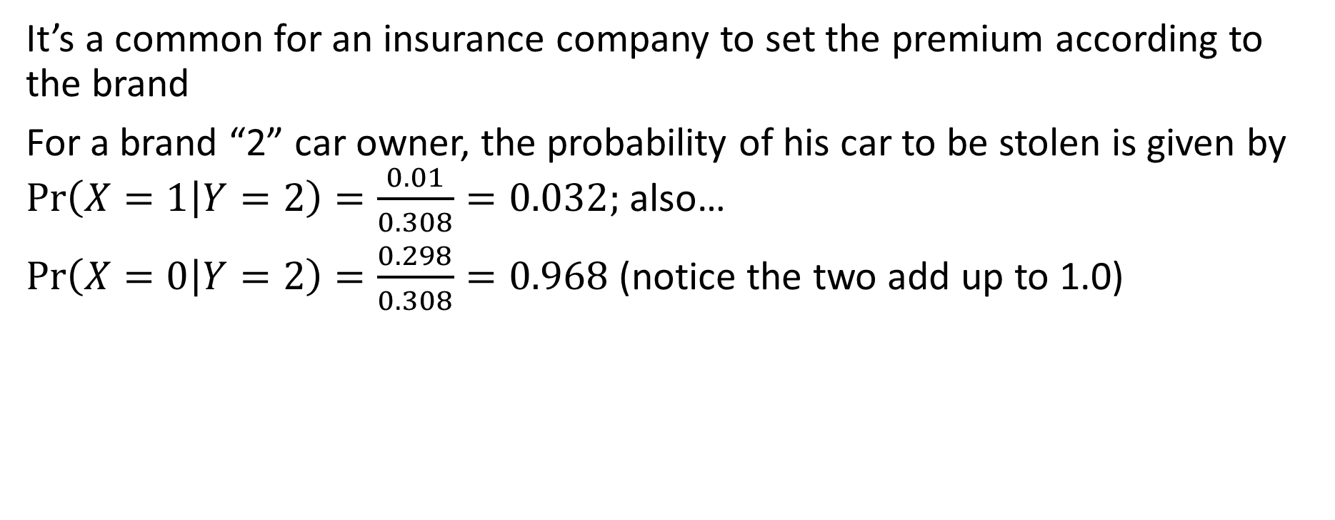
Example: automobile theft
It’s a common for an insurance company to set the premium according to the brand
For a brand “2” car owner, the probability of his car to be stolen is given by $\operatorname{Pr}\left(X=1 | Y=2\right)=\frac{0.01}{0.308}=0.032;$ also…
$\operatorname{Pr}\left(X=0 | Y=2\right)=\frac{0.298}{0.308}=0.968$ (notice the two add up to 1.0)
 | Brand (Y)
 | 1 | 2 | 3 | 4 | 5 | Total
No (X=0) | 0.129 | 0.298 | 0.161 | 0.28 | 0.108 | 0.976
Yes (X=1) | 0.01 | 0.01 | 0.001 | 0.002 | 0.001 | 0.024
Total | 0.139 | 0.308 | 0.162 | 0.282 | 0.109 | 1

Slide 6

Conditional distributions
 | Brand (Y)
 | 1 | 2 | 3 | 4 | 5
No (X=0) | 0.928 | 0.968 | 0.994 | 0.993 | 0.991
Yes (X=1) | 0.072 | 0.032 | 0.006 | 0.007 | 0.009
$\operatorname{Pr}\left(X=x | Y=y\right)$
for y=1,2,…,5
$\operatorname{Pr}\left(Y=y | X=x\right)$
for x=0, 1
 | Brand (Y)
 | 1 | 2 | 3 | 4 | 5
No (X=0) | 0.132 | 0.305 | 0.165 | 0.287 | 0.111
Yes (X=1) | 0.417 | 0.417 | 0.042 | 0.083 | 0.042

Slide 7
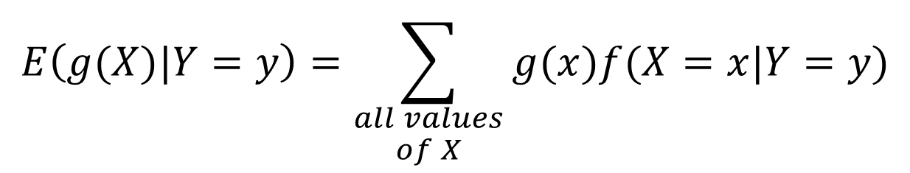
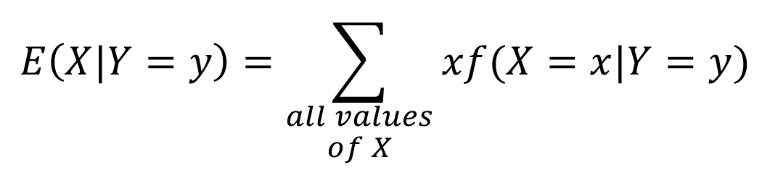
Calculating conditional expected value
Conditional expected values combine the ideas of “conditional probabilities” and “expectation”
$$E\left(X|Y=y\right)=\sum_{\begin{aligned}all values \\ of X\end{aligned}}{xf(X=x|Y=y)}$$
$$E\left(g(X)|Y=y\right)=\sum_{\begin{aligned}all values \\ of X\end{aligned}}{g(x)f(X=x|Y=y)}$$

Slide 8

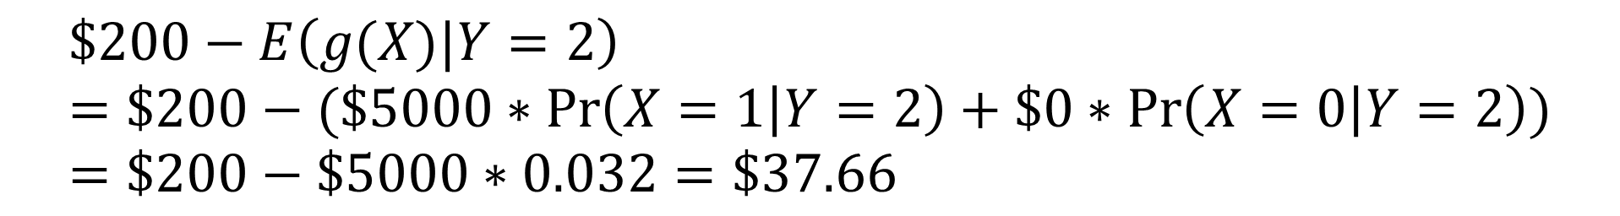
Example: automobile theft (contd.)
Suppose the insurance company charges the Brand-2 car owner $200 premium, under the condition that the company will pay $5000 if the car is stolen
What is the expected profit of this insurance deal?
 | Brand (Y)
 | 1 | 2 | 3 | 4 | 5
No (X=0) | 0.928 | 0.968 | 0.994 | 0.993 | 0.991
Yes (X=1) | 0.072 | 0.032 | 0.006 | 0.007 | 0.009
$$\$200−E\left(g(X)|Y=2\right)=\$200−(\$5000∗\operatorname{Pr}\left(X=1 | Y=2\right)+\$0∗\operatorname{Pr}\left(X=0 | Y=2\right))=\$200−\$5000∗0.032=\$37.66$$
$$g:the payout of the company$$

Slide 9

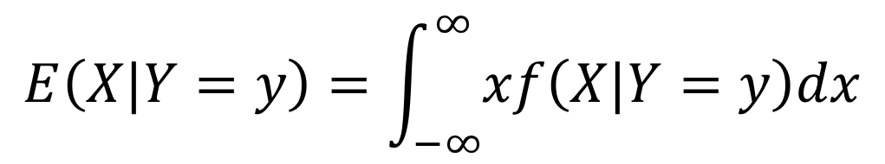
(FYI only) Calculating conditional expectations for a continuous variable
Conditional expectations combine the ideas of “conditional probabilities” and “expectation”
$$E\left(X|Y=y\right)=\int_{−∞}^{∞}{xf\left(X|Y=y\right)dx}$$
where $f\left(X|Y=y\right)=f(X,Y=y)/f(Y=y)$

